Slide 1




Integrated Sensing and Communication between Daily Devices and mmWave Radars
Kaiyan Cui^{1,2}, Qiang Yang¹, Leming Shen¹, Yuanqing Zheng¹, Jinsong Han³
¹The Hong Kong Polytechnic University
²Xi’an Jiaotong University
³Zhejiang University

Slide 2
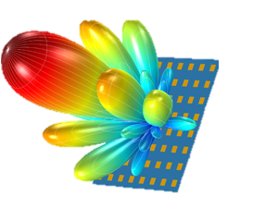



wavelength
1cm
1mm
frequency
30GHz
300GHz
mmWave
radar
mmWave
High sensing resolution
All-weather conditions
Notes:
mmWave radar is a promising sensors that works in the higher frequency range with a shorter wavelength. Compared to other technologies, it has unprecedented sensing resolution and can work in all weather conditions.

Slide 3

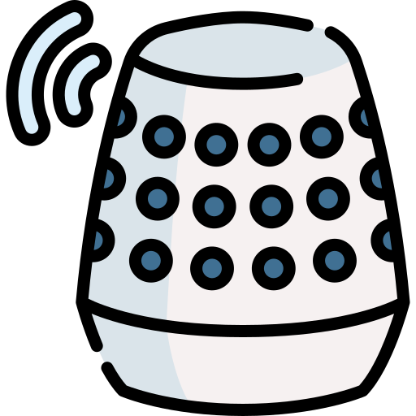

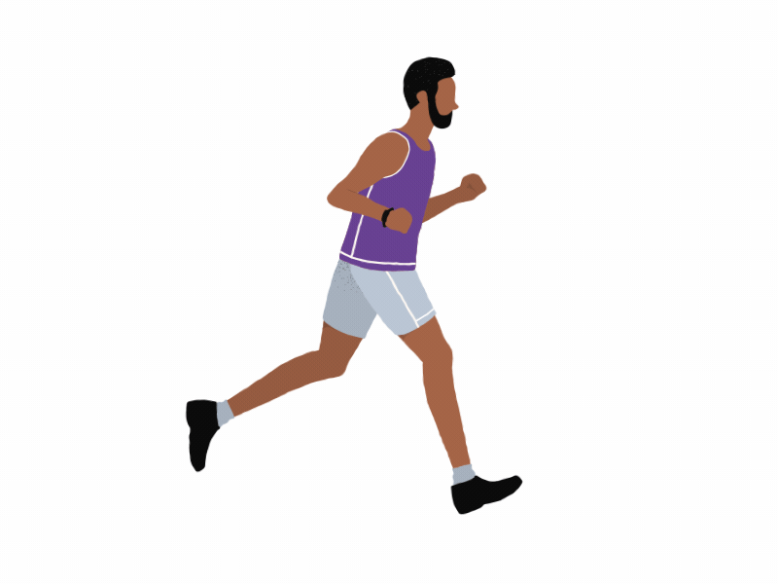

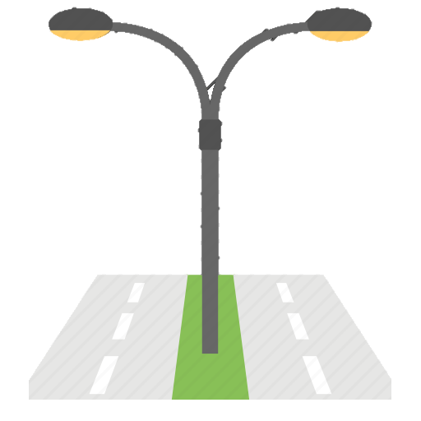

home appliances
gestures
robots
activities
vehicles
mmWave
radar
vital signs
road infrastructure
Notes:
Recently, mmWave radar has been widely deployed in various devices to sense human gestures, activities and even vital signs.

Slide 4
Sensing
＋
Communication?
mmWave
radar
Notes:
Besides the powerful sensing function, can we empower the mmWave radar with communication capability? If so, we can support both sensing and communication and enable some interesting applications.

Slide 5
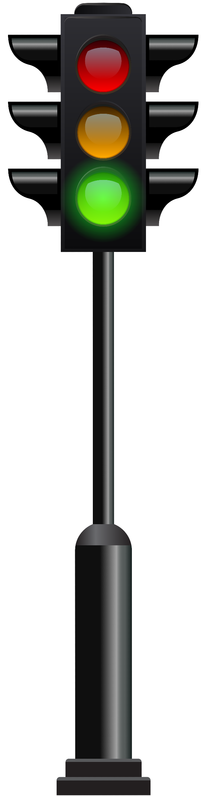







Sensing
Sensing
Communication
Communication
Extending the pedestrian flashing green time
Sensing
＋
Communication
P2I communication
Multi-object sensing and communication
Notes:
For example, Pedestrian-to-Infrastructure communication. After receiving the "crossing" message from an elderly, the traffic light embedded with mmWave radar can suitably extend the flashing green time and meanwhile track her movement to protect her.
In addition, mmWave radar can be deployed at the entrance of a venue to monitor visitors, while simultaneously checking their COVID-19 vaccine passports by decoding their sending messages.

Slide 6

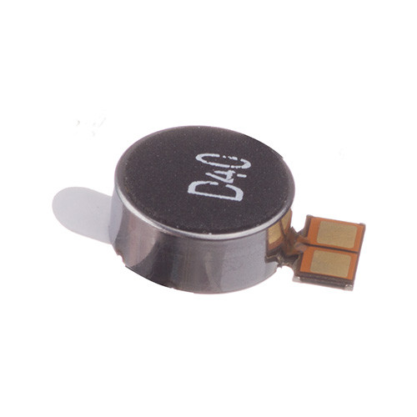
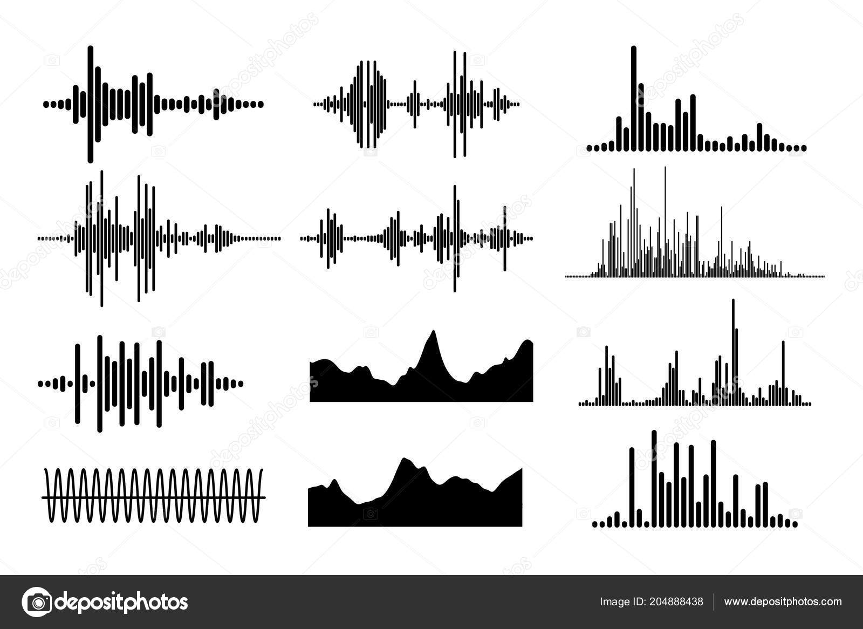

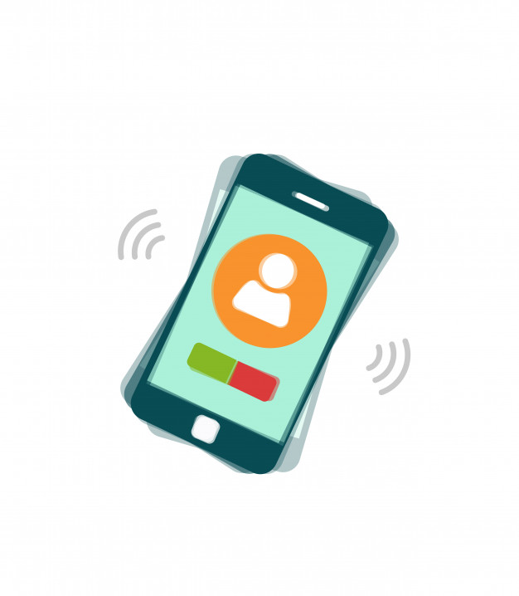



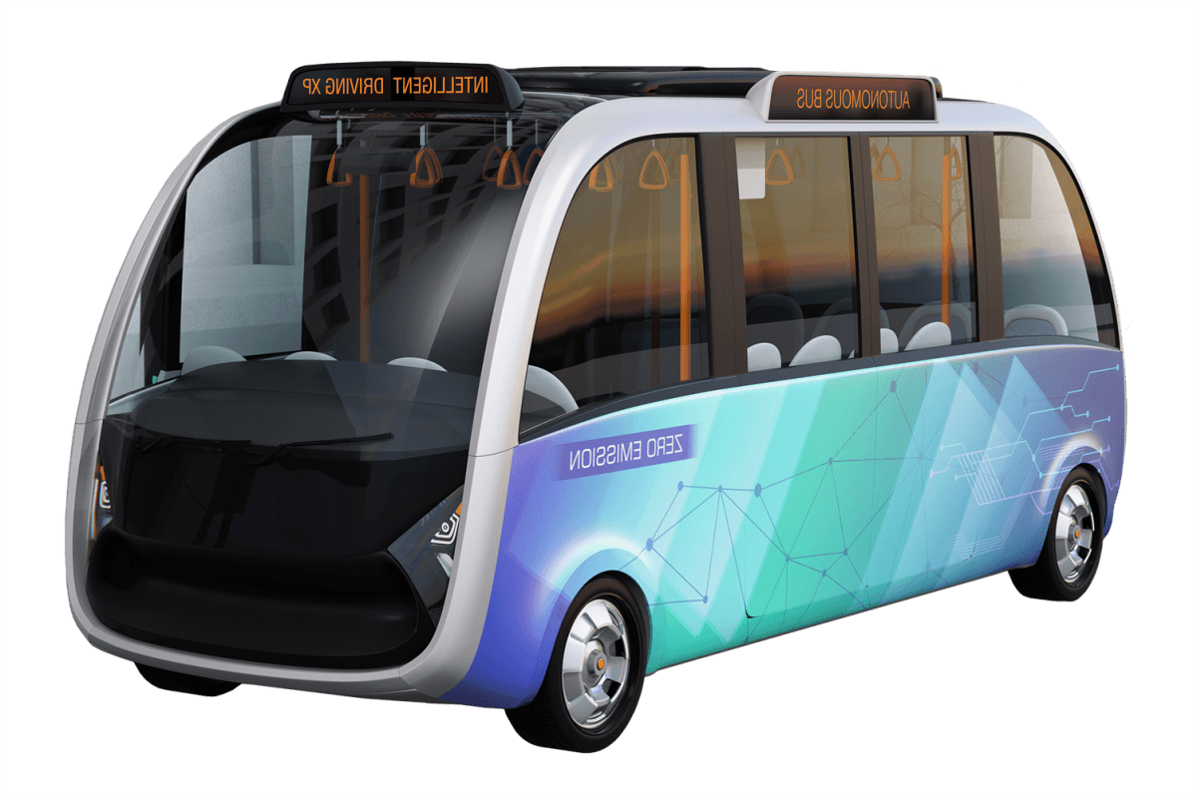
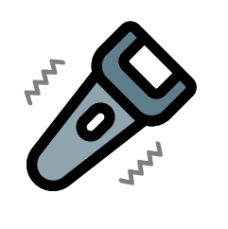
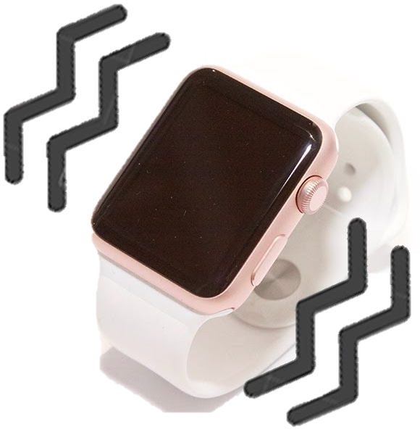
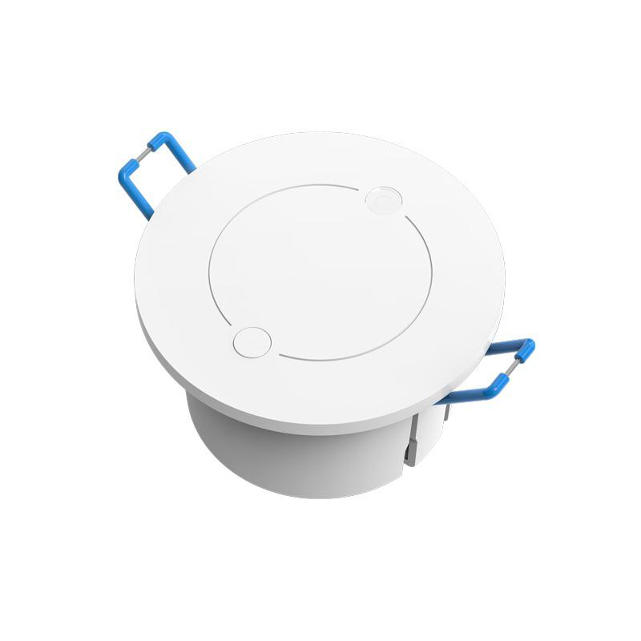
VibBeat
Sensing
＋
Communication
Vibration Pattern
Design
Vibration Signal Recovery & Decoding
Transmitter Identification
Vibration Signal Generation
Object Detection
vibra-motors
mmWave radar
Transmitter
Receiver
Notes:
To this end, we propose VibBeat, allowing daily devices to communicate with millimeter wave radars through vibrations. In which, a daily device, like smartphone and smartwatch, sends messages by modulating vibrations, while a mmWave radar receives the messages by detecting and decoding the vibrations with reflected mmWave signals.
By doing so, the device or user can not only be passively sensed by a radar, but also actively send messages to the radar for a personalized response.

Slide 7
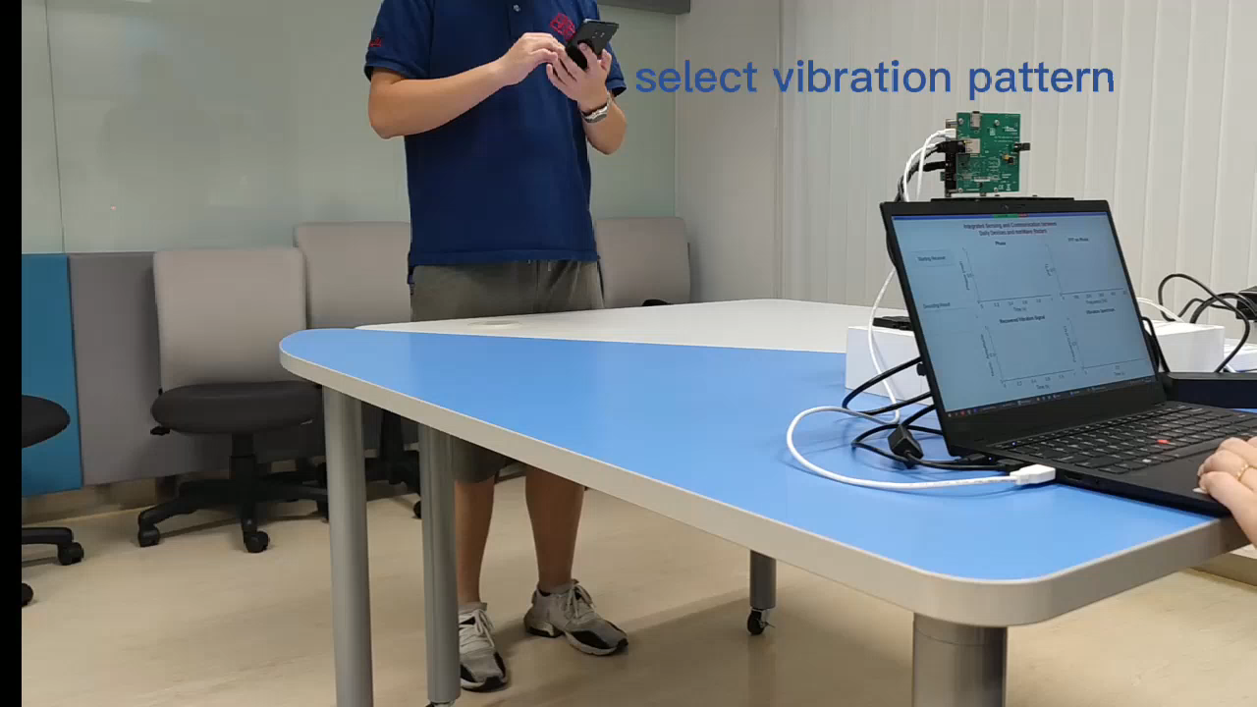
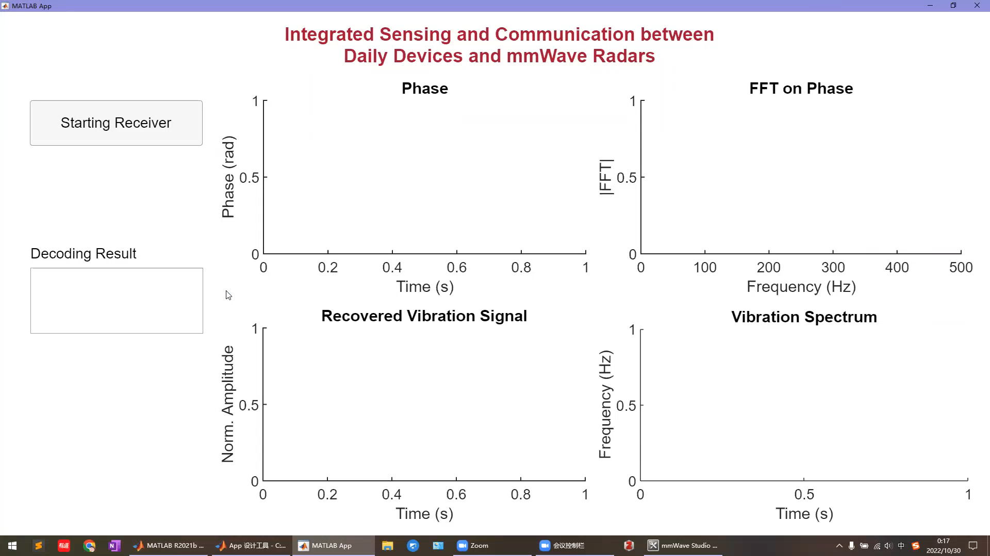
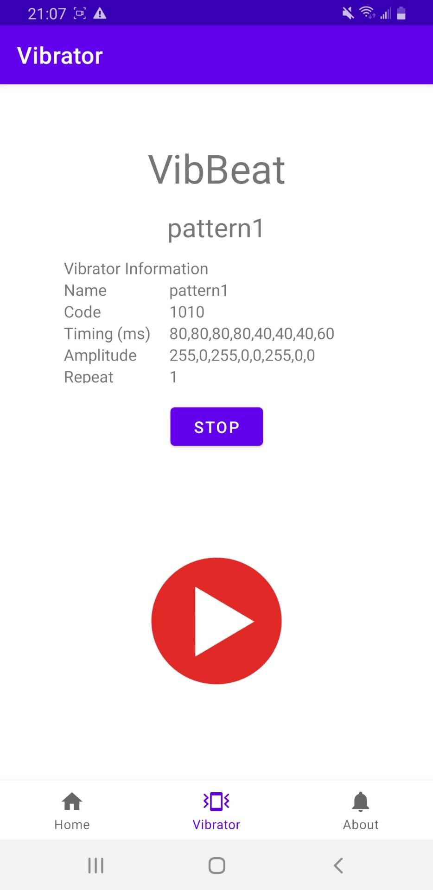
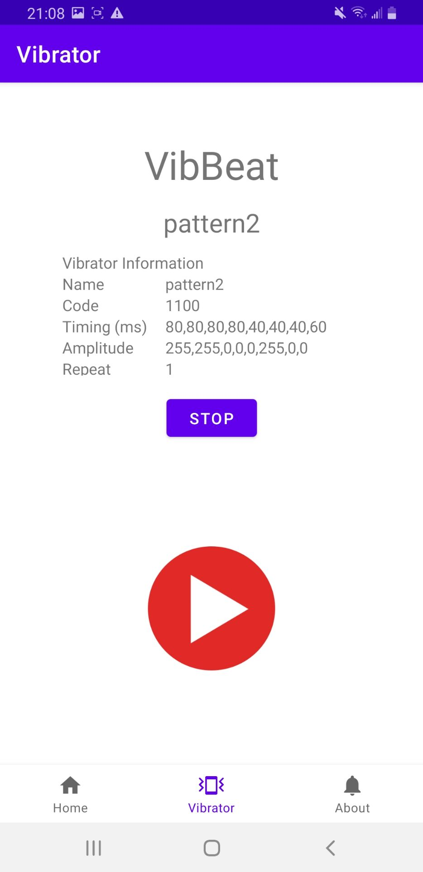
VibBeat – Demo
mmWave
radar
APP
PC

Slide 8

Thanks!

